Slide 1

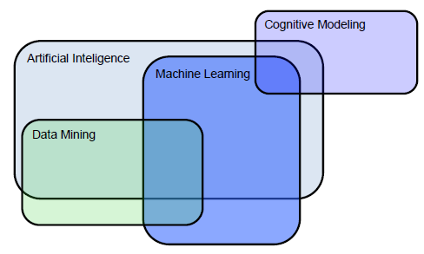
Laboratory for Cognitive Modeling
University of Ljubljana
Faculty of Computer and Information Science

Slide 2

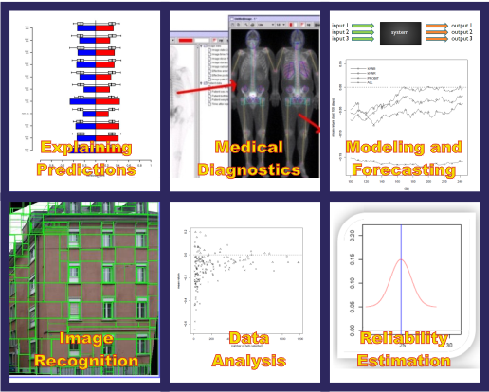
Development of Machine learning methods for intelligent data analysis and data mining

Slide 3
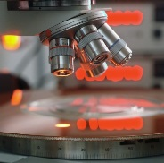



Intelligent data analysis
Analysis of rules and modeling of different data (numerical, symbolic, images, text documents)
Evaluating quality, reliability and data interaction, explaining individual predictions
Development of new Machine learning approaches
Applications in medicine, financial industry, economy
Different
data
sources
Model
Data mining

Slide 4
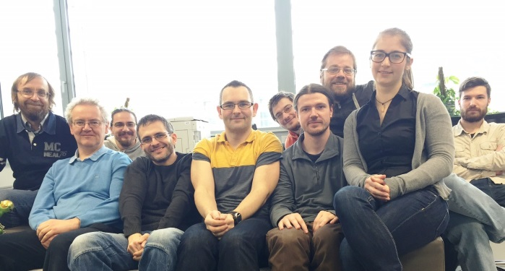
Prof. Dr. Igor Kononenko
Assoc. Prof. Dr. Marko Robnik Šikonja
Assoc. Prof. Dr. Zoran Bosnić
Assist. Prof. Dr. Matjaž Kukar
Assist. Prof. Dr. Erik Štrumbelj
Dr. Jana Faganeli Pucer, R
Dr. Domen Košir, R
Assist. Petar Vračar, M.Sc.
Assist. Matej Pičulin
Assist. Kaja Zupanc
Miha Drole, R
Martin Jakomin, JR
Dr. Darko Pevec (Visiting memb.)
Dr. Ercan Canhasi (Visiting memb.)

Slide 5
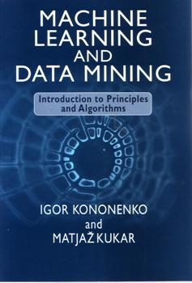
Experience in research and development
Authors of more than 300 papers
in high quality journals and books
(more than 2000 SCI citations)
12 university textbooks, 18 PhD theses
20 MSc theses, 220 BSc theses
Members of journal editorial boards and conferences‘ programme committee members
Years of experience in modeling
in the areas of medicine, marketing,
financial industry, telecommunications etc.
More than 20 completed projects.

Slide 6
Projects
- Artificial intelligence and intelligent systems 2015-2020
- Software for continuous reporting of air quality, 2015-2016
- Quantitative methods in telecommunications, 2015-2016
- Basketball analytics, 2015
- Homogenization of PM10 measurement time series, 2015
- Statistical analysis in insurance, 2015
- Centre for language resources and tech. UL, 2015-2020
- Upgrade of corpuses (cc)Gigafida, (cc)Kres, 2015-2018
- (Un)Supervised learning from imbalanced data, 2014-2015
- Modeling of gene based cancer classification, 2014-2015
- E-learning models for game-based learning, 2014-2015
- AGROIT - Increasing the efficiency of farming, 2014 - 2016

Slide 7
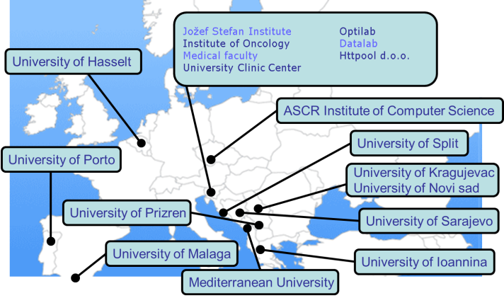
Research collaboration

Slide 8
Major achievements by LKM, that make us known worldwide:
- Algorithm for non-myopic attribute evaluation ReliefF
- Variants of (semi) naive Bayesian classifier
- using MDL for attribute evaluation and tree pruning
- General method for efficient explanation of individual predictions in classification and regression for arbitrary model - General methods for estimating the reliability of individual predictions in classification and regression for arbitrary model - applications in medical diagnosis
- Opensource packages in R: CORElearn, semiArtificial and ExplainPrediction

Slide 9
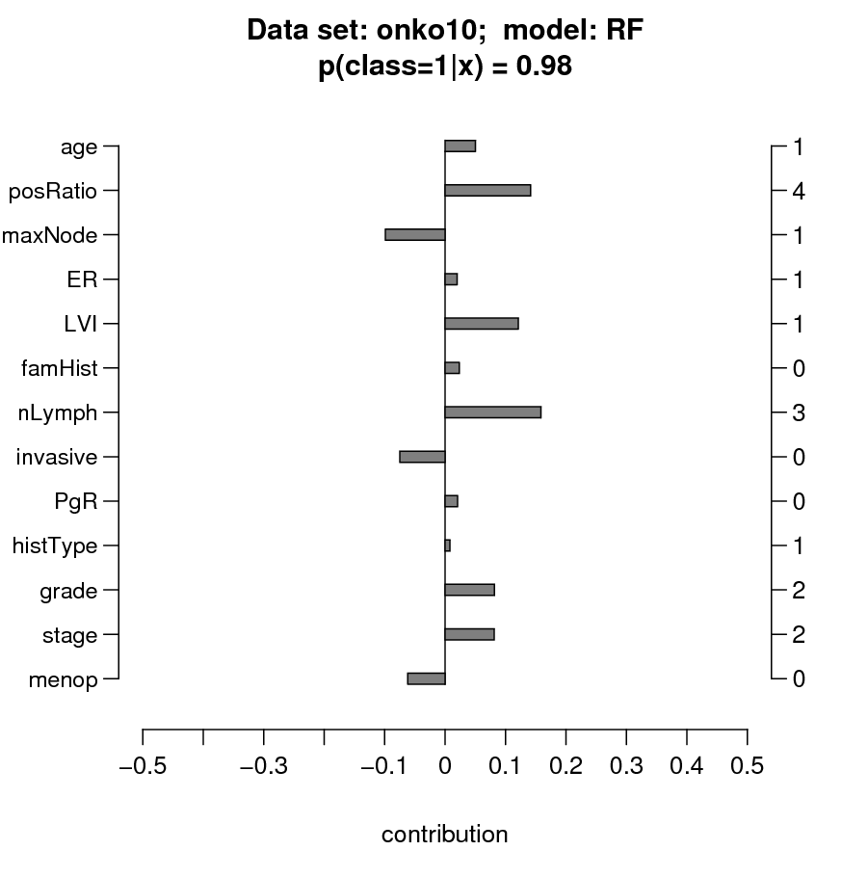
Explaining predictions
We developed general methods for explaining individual predictions and models.

Slide 10
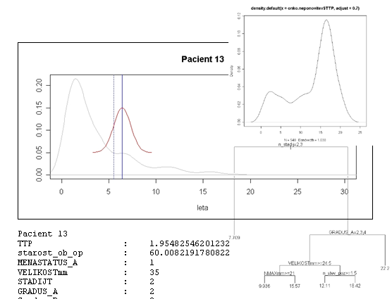
Reliability estimates
New methods for estimating reliability of individual regression predictions

Slide 11
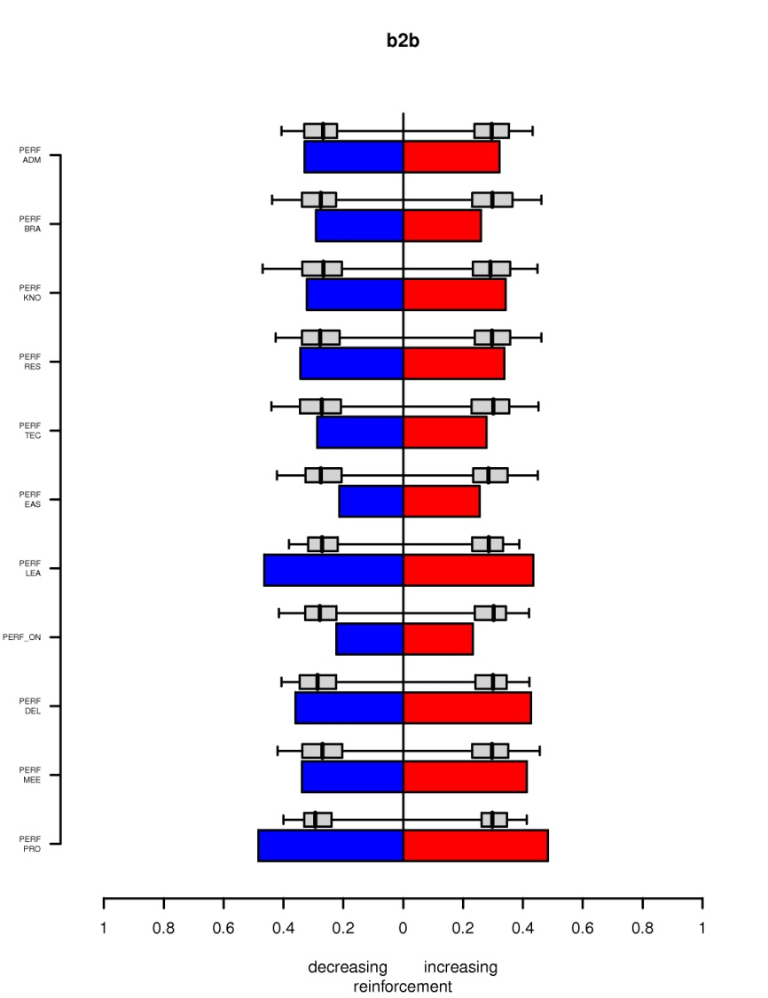
Marketing
Modeling the decision making process of a customer
How to optimally place the ads on a web page?
When is the best moment for TV advertising?

Slide 12
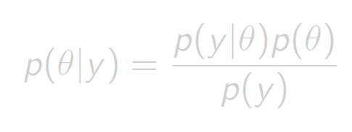
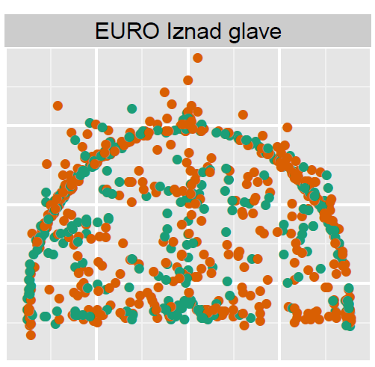
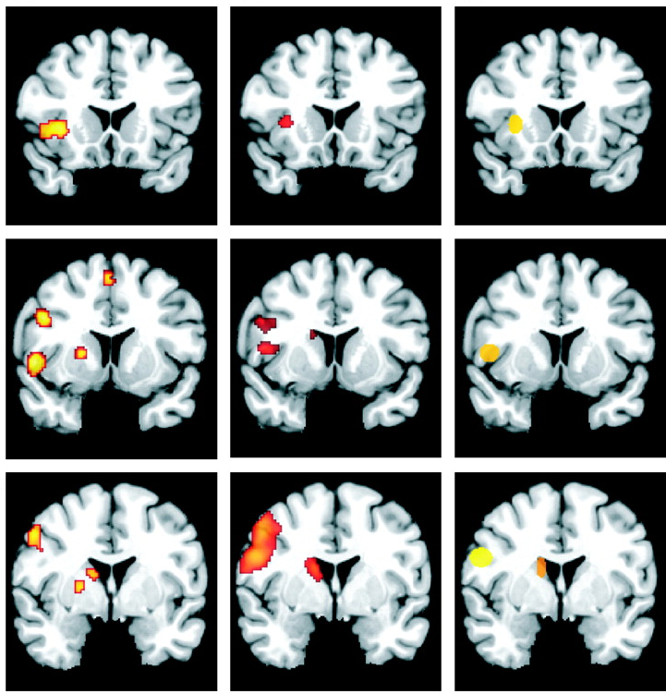
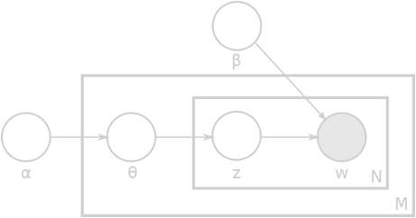
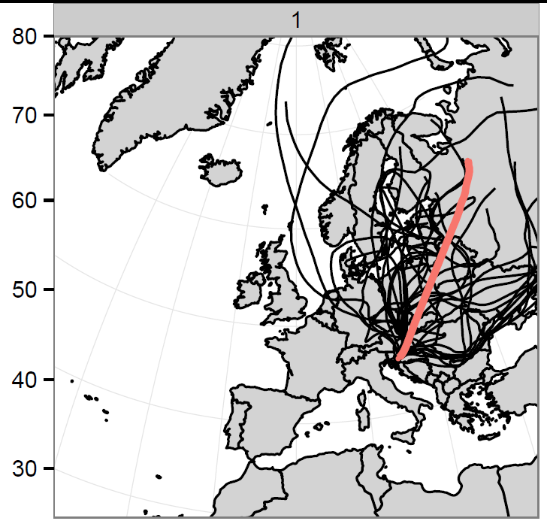
Statistics
Statistics and statistical machine learning
computational statistics
and applications

Slide 13
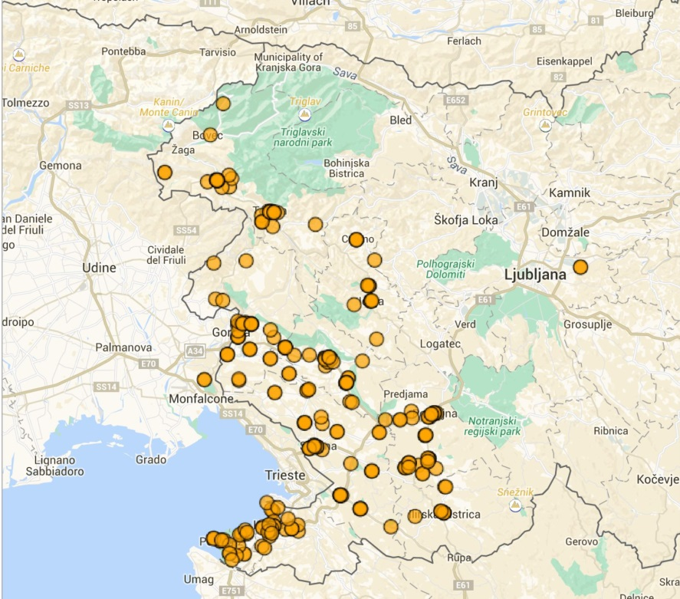
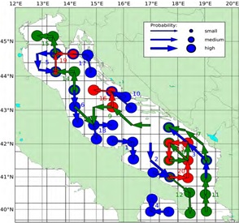
Data mining of spatio-temporal data
Modeling of water mass movement in the Adriatic and Mediterranean
Impact of water currents on reproduction of jellyfish
Modeling air currents and analysis of air pollution at various locations in Europe

Slide 14


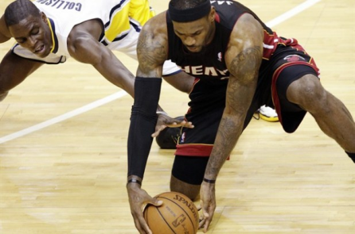
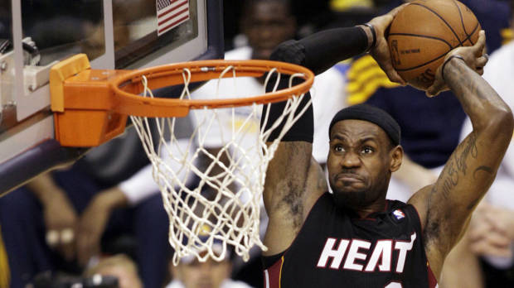

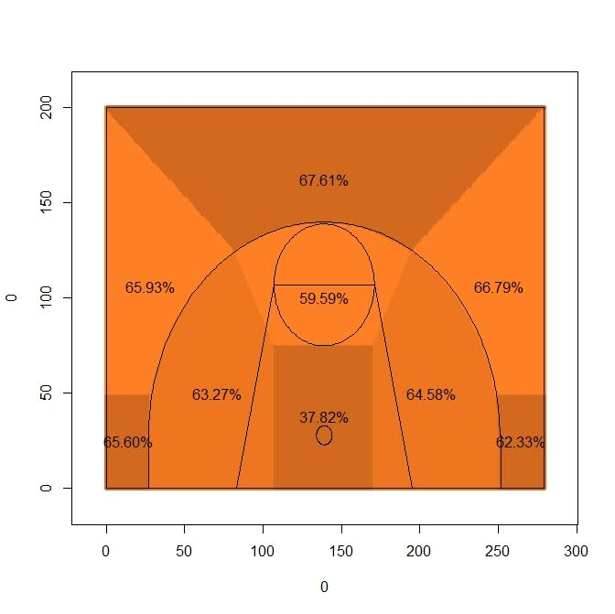


Advanced Sports Analysis
What will happen next?
How strong is the team?
P₁
P_{a}
P_{k}
P_{b}
P_{n}
?
:

Slide 15
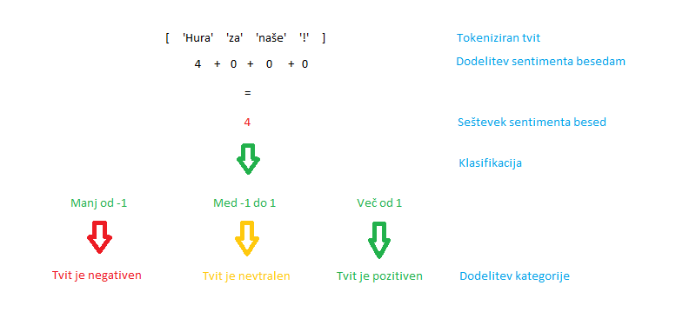
Text mining
semantic similarity of text based on clusters and linguistic resources
multiple documents summarization using Archetypal analysis
natural language processing in general-purpose databases
sentiment analysis of texts and online resources
Profiling of web users
Web usage mining
User profiling
Recommendation systems

Slide 16

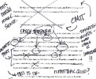
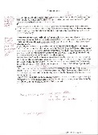
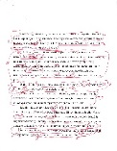
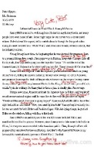
E-Learning
Recommendation of learning material
Solutions for the cold-start problem
Automated Essay Evaluation
Extraction of syntax, content, coherence, and semantic attributes
Prediction of the final grade.
Providing a semantic feedback to students using entity recognition, coreference resolution, information extraction, and building and determining the consistency of an ontology
AEE
GRADE &
FEEDBACK

Slide 17
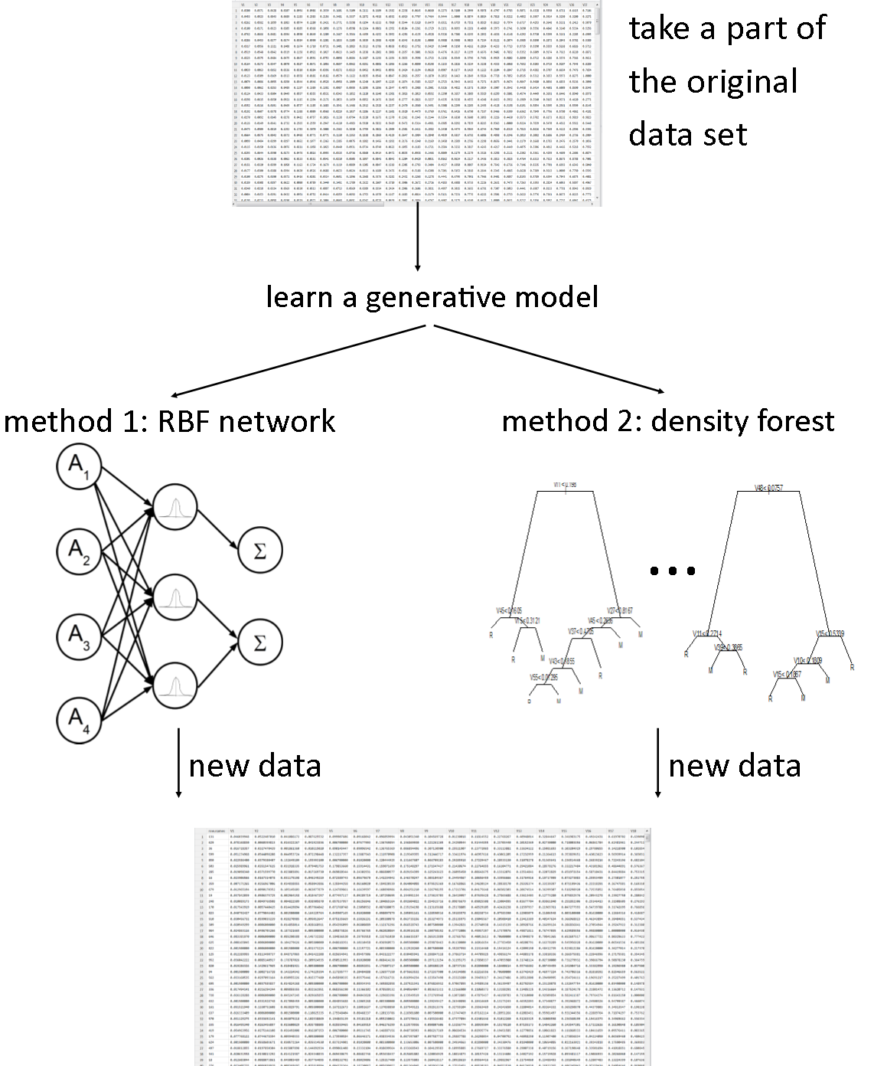
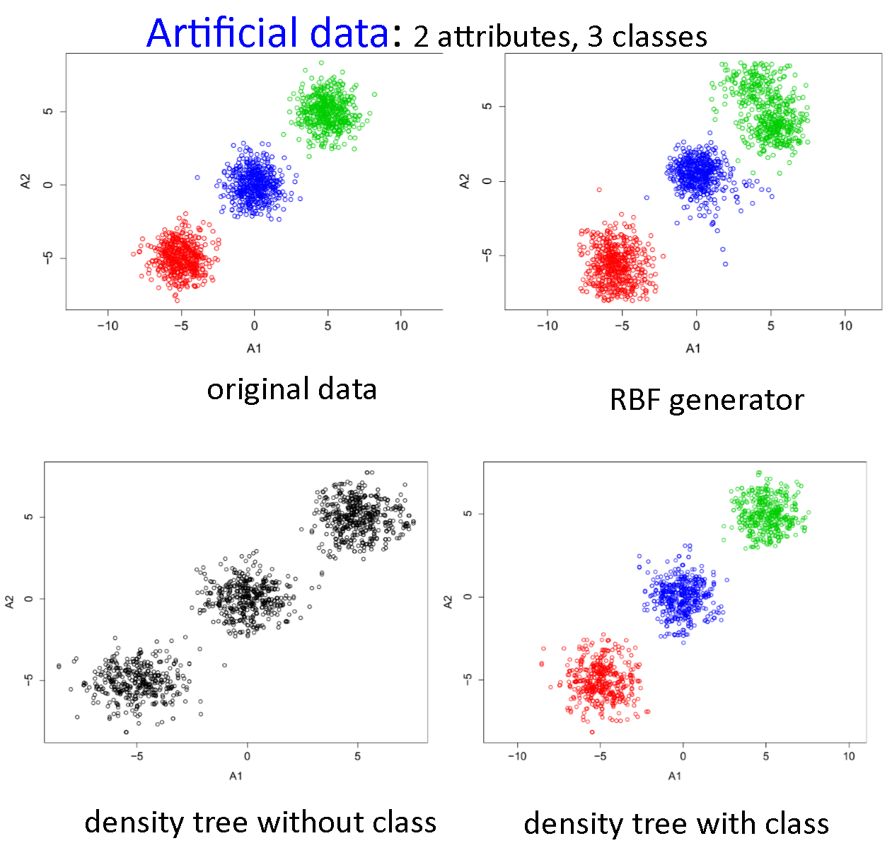
Generating semi-artificial data
when there is not enough data
for simulations
for imbalanced data
to improve prediction performance

Slide 18
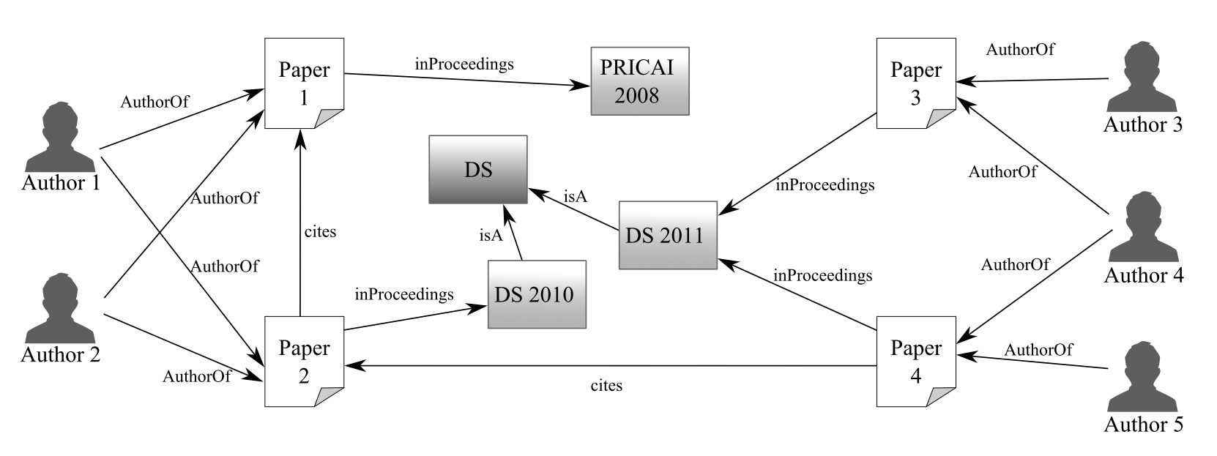
Graph mining
graph vectorization
treating relations as graphs
efficient implementation of algorithms for graph mining in graph databases
enrichment of graphs with text based information

Slide 19

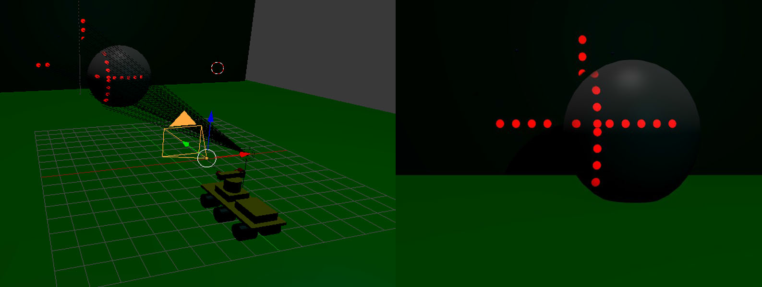
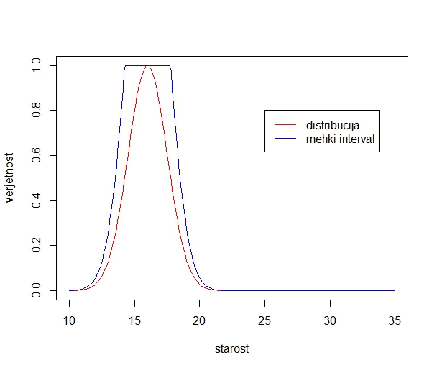
Other areas of research
Inductive logic programming:
efficient bottom-up approaches
use of negation
learning from depth-sensor data
possible applications in chemistry, genetics...
Modeling probability distributions and rulelearning using ant colony optimization
ECG analysis
Analysis of poll and ordinal data
Feature selection and attribute dependency discovery
Mining and fusion of data streams
Matrix factorization and deep learning

Slide 20
Why collaborate with us
We help you to analyse your data and discover new regularities
We enhance your dataset and help you to define a scenario/methodology for its analysis
We upgrade your model with explanation and reliability estimates
Together with you, we find relevant parameters for modeling and develop algorithms for processing your signals
We support your analytics with statistical approaches
Together with you, we develop a recommender system with optimal recommendations
We structure and summarize your numerous texts/documents

Slide 21
What can we do for you
improve your business by implementing business intelligence into your ERP and CRM systems
help recognize behaviour of your clients and suit your services to them
reduce costs of your business by optimizing business processes
consult and educate in data storage and intelligent data analysis
enable planning and forecasting of business success in the future
explore factors that influence your business success
ensure your advantage over business competitors by using modern forecasting tools

